Slide 1
DriverPass Online and on the road Instructional system

Slide 2
System requirements
Training drivers for DMV tests locally
High Pass rate
We need online classes
Instructor to peer classes.
Online registration
Online instructor training schedules
Notes:
The solution to drivers failing their tests will lie in training drivers online and off-site. This web system will consist of online registration that leads you to packages to be bought for students. Hopefully, this model of schooling and training will enable the DMV to have a high pass rate. The system will take payments online and check for instructor availability.

Slide 3
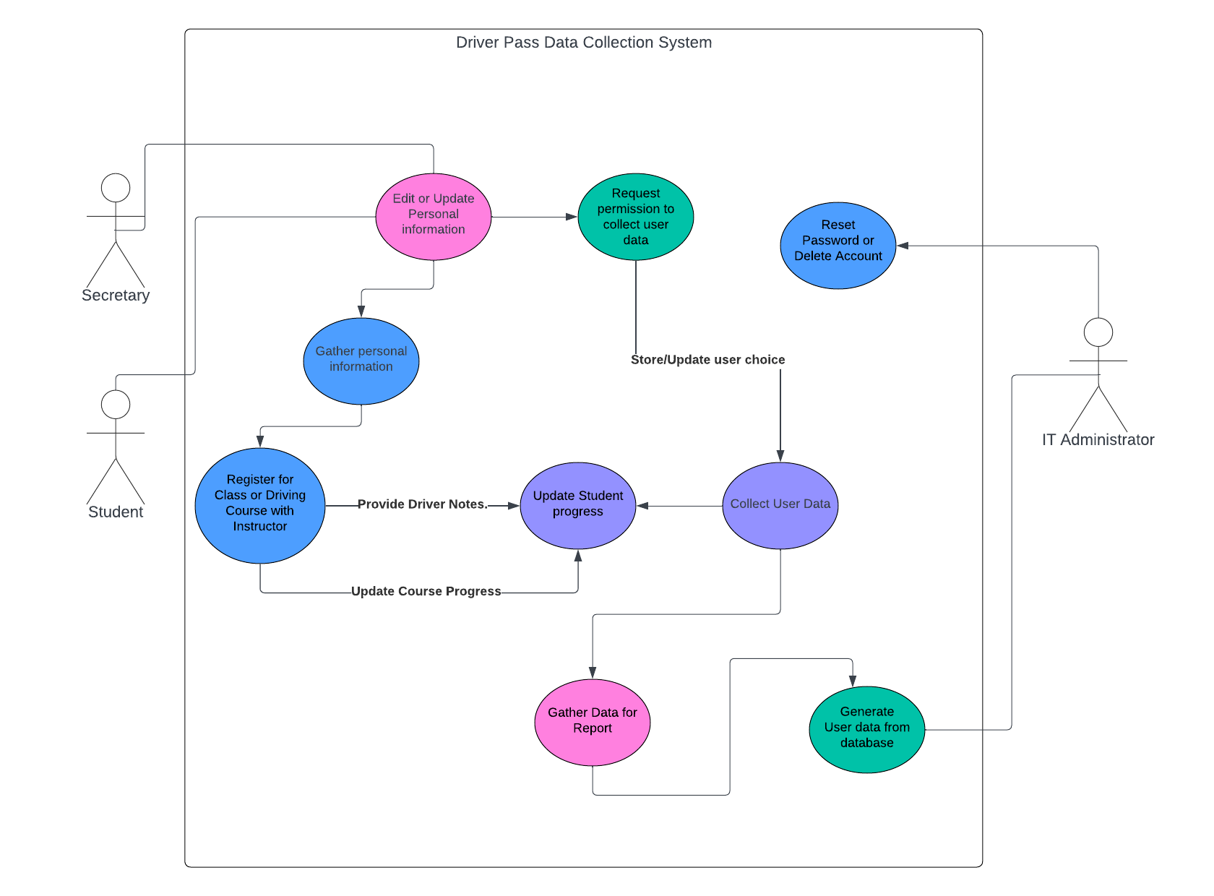
Use Case diagram
Notes:
We have a simple registration event upon the web sites portal. This use case will be evident and started as soon as any student lands on the homepage unless they are seeking information. The student or secretary will input his/her information and also agree to data collection. The data collection will be for the project owner to get progress on the efficacy of the courses and instructors. Once this data request is accepted this will update the function on the database to this option. The student will be able to register for an online course or a driving course with instructor. This is the simplest flow that can transpire to ensure a student successfully enrolls. Then we can gather the data from students that have allowed their data to be collected and we can generate a report and send it back to the appropriate channels.

Slide 4
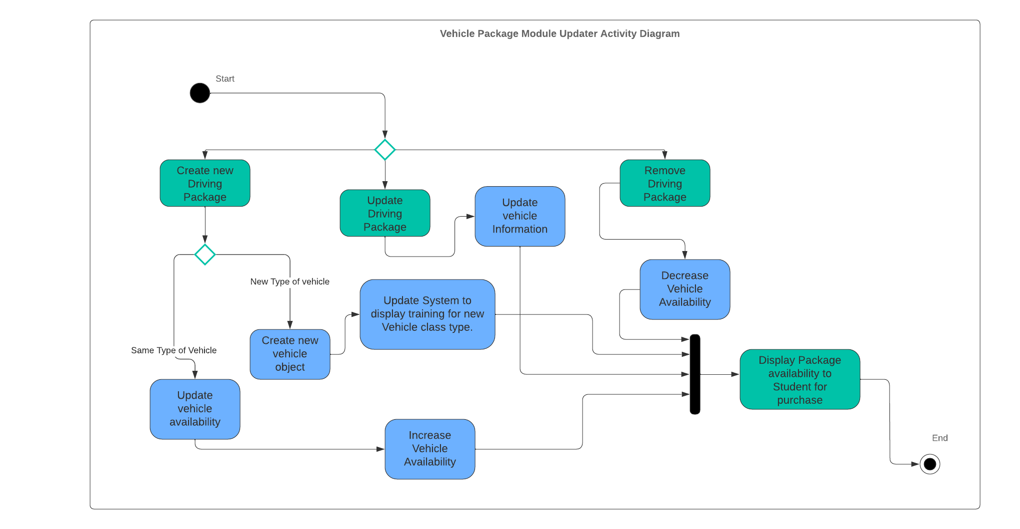
Activity Diagram
Notes:
This activity diagram will show how to update a new package or vehicle to the web's portal. The web's portal is going to be accessed by a developer to update the modules because it will take longer to configure a system with components that can be clicked and dropped with some new text. This would delay our project but can be further researched but the important thing is to create a database of knowledge for DMV students to pass testing.

Slide 5
security
Login using 2FA.
Database password hashing.
Sensitive data encryption, such as home address, phone number, and social security number.
HTTPS/TLS website security to mitigate Man-in-the-Middle Attack vectors.

Slide 6

System limitations
Web/cloud based system means other companies will be managing security, uptime, and database needs.
This system will not accommodate a million users concurrently because it is being used at one location.
The website will have to be handled by developers for module updates until such another system is created for updates to driving packages.

Slide 7

Thank you
Andres Trujillo
CS 255 Systems Analysis and Design
andres.trujillo@snhu.edu
4/21/2024

